Slide 1
Farm Robot project

Slide 2
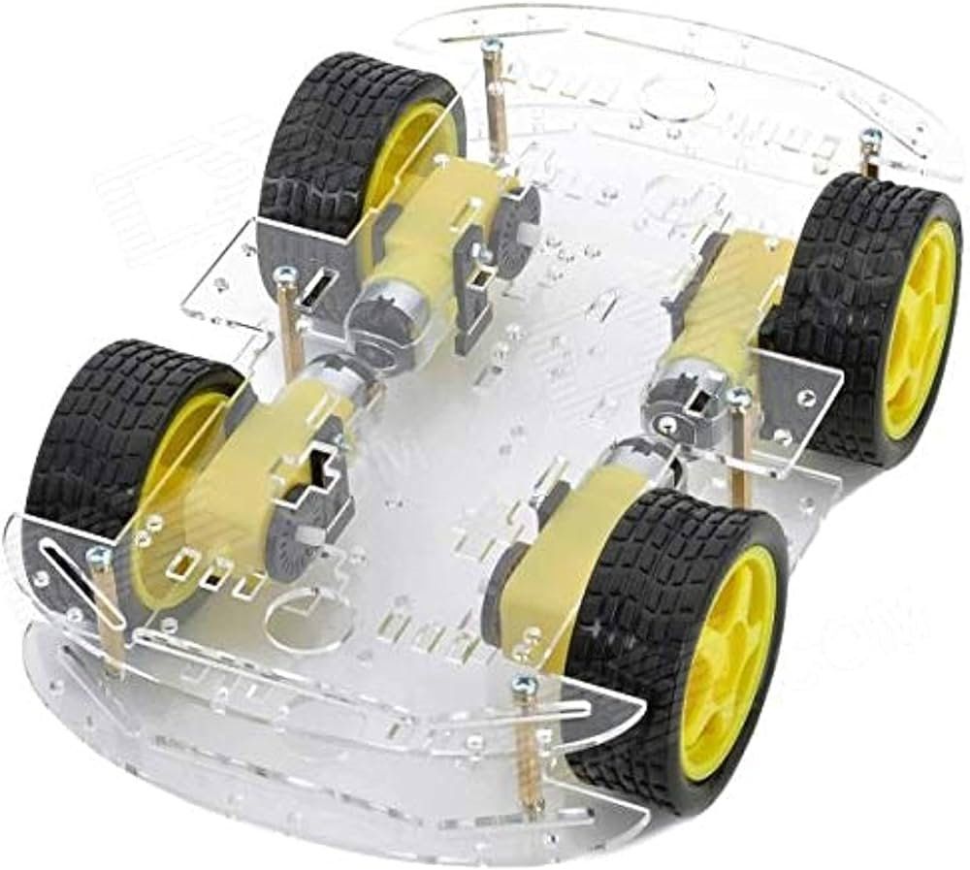
4WD ROBOT SMART CAR

Slide 3

ARUINO UNO

Slide 4

WIRES

Slide 5
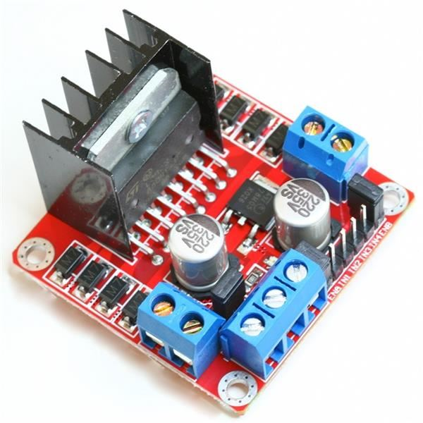
DUAL H-BRIDGE DC & STEPPER MOTOR DRIVER L298N

Slide 6
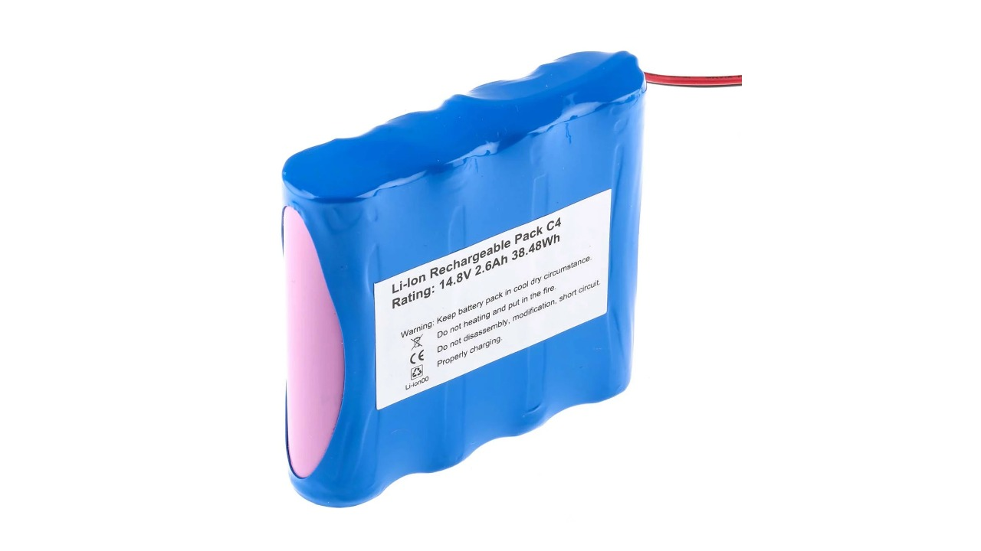
14.8V Lithium-Ion Battery Pack, 2.6Ah

Slide 7
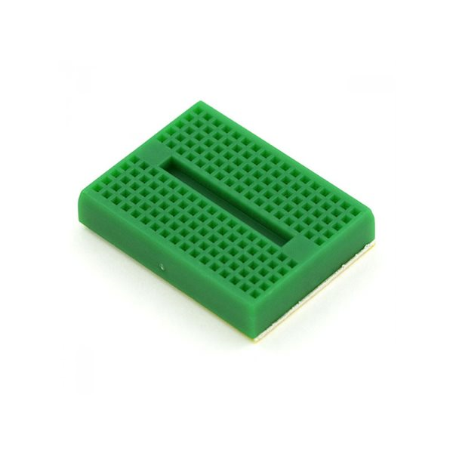
BREADBOARD 170 TIE-POINT

Slide 8
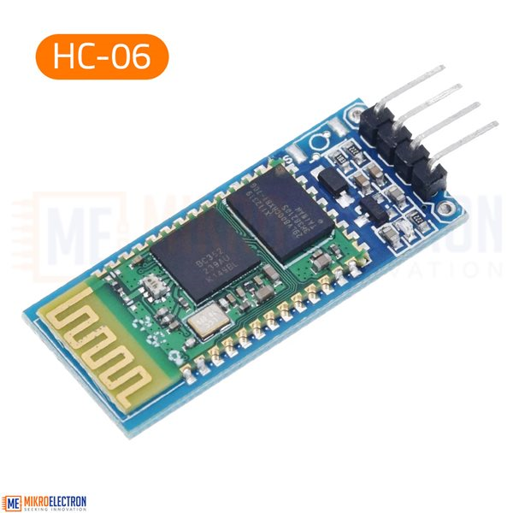
HC-06 BLUETOOTH UNIT

Slide 9
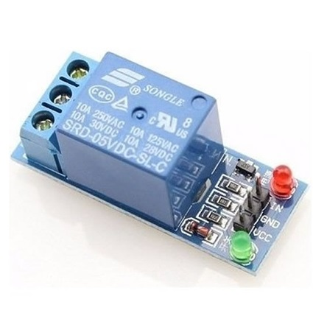
RELAY

Slide 10
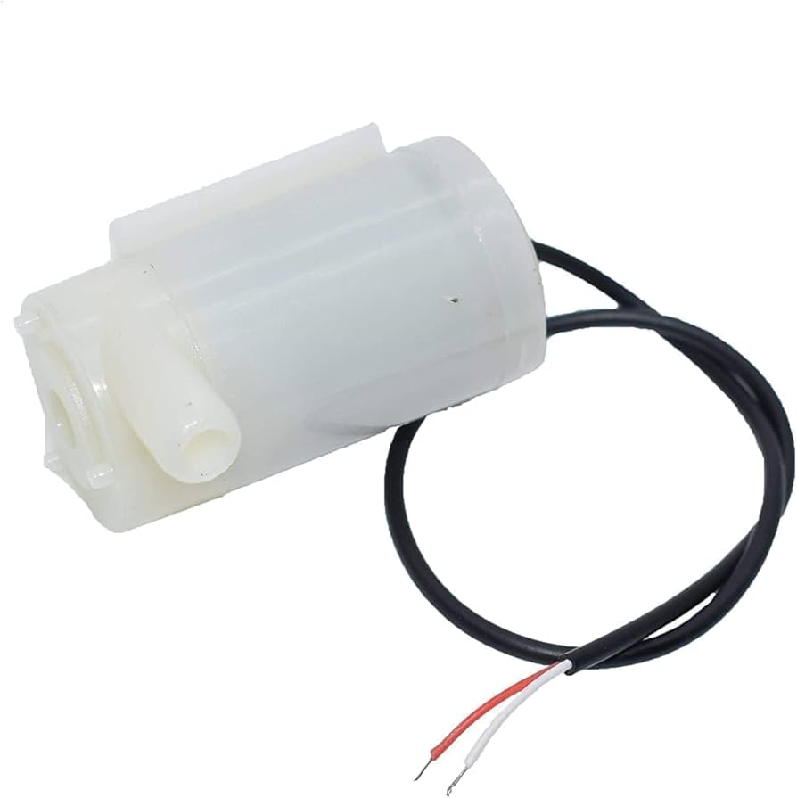
WATER PUMP

Slide 11
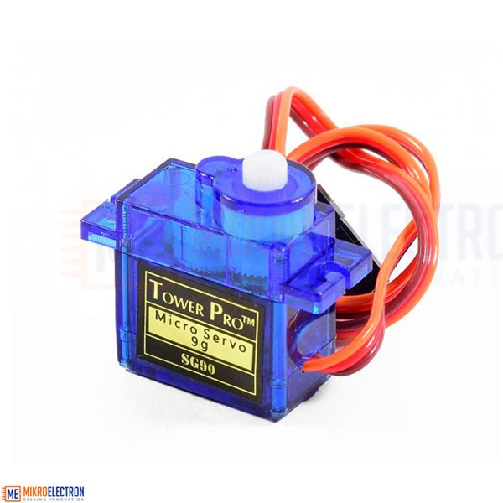
MINI SERVO MOTOR

Slide 12
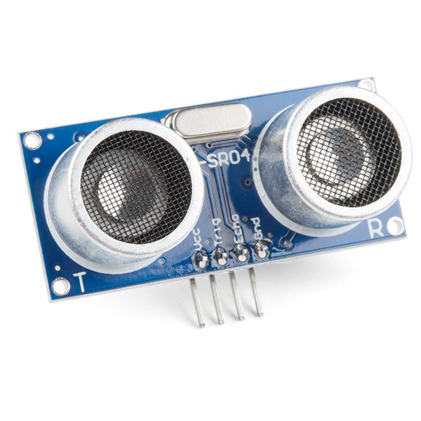
Ultrasonic Distance Sensor

Slide 13

WIND MOTOR

Slide 14
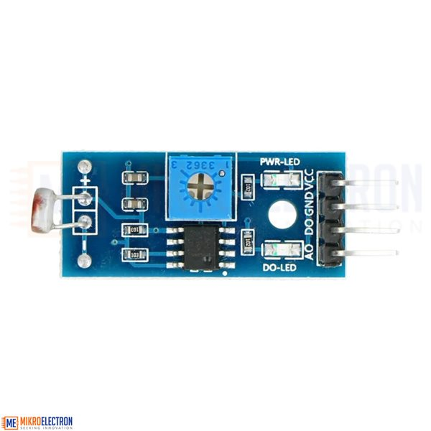
LDR LIGHT SENSOR MODULE

Slide 15
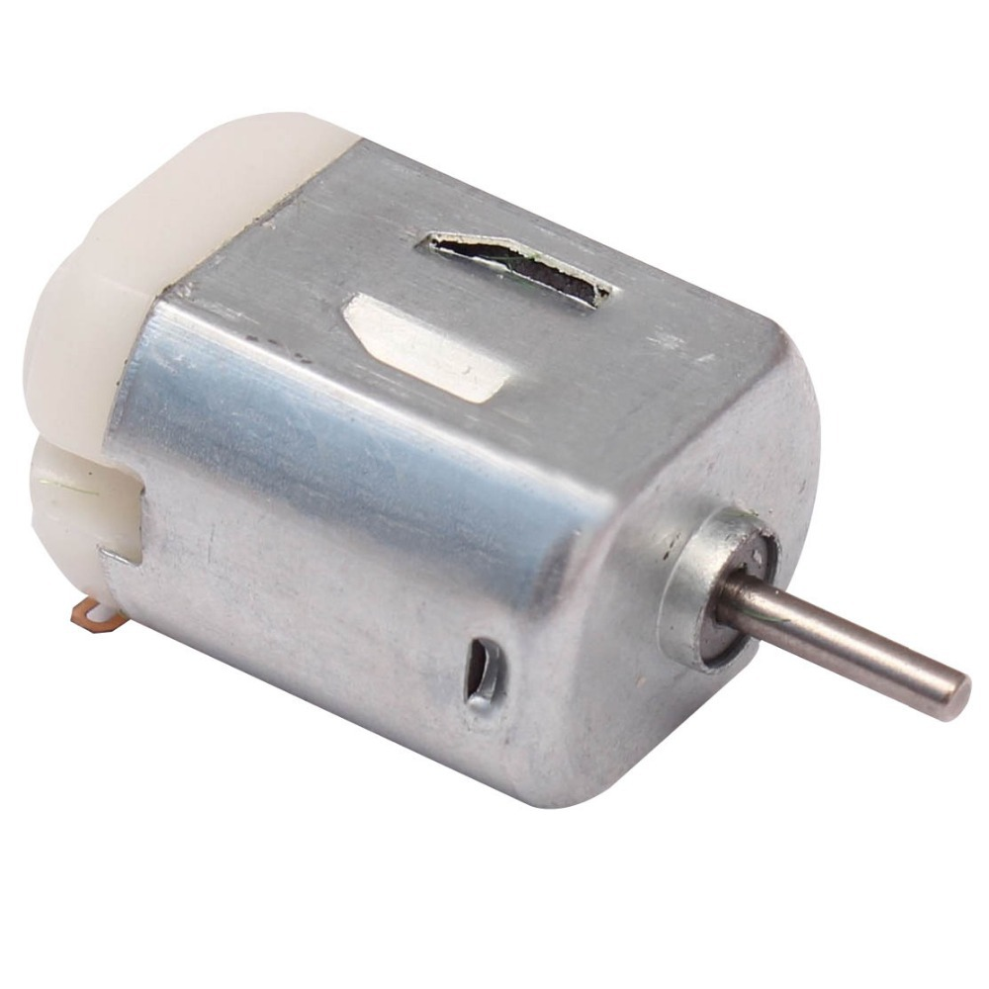
5V DC motor

Slide 16
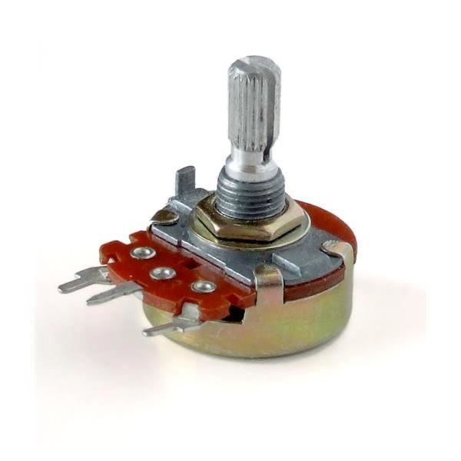
5K OHM LINEAR TAPER ROTARY POTENTIOMETER RESISTOR

Slide 17

LED Strip Light

Slide 18
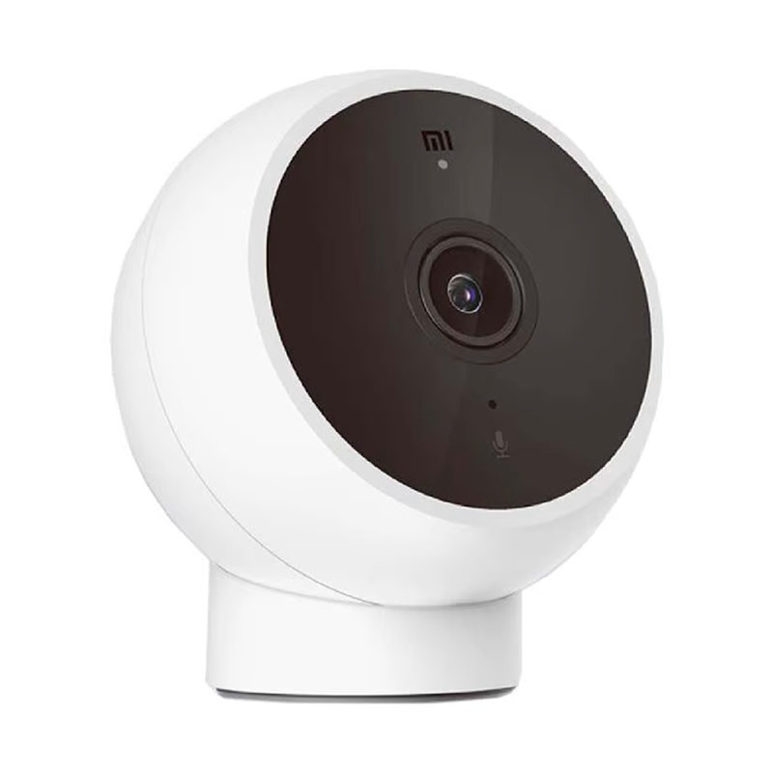
Mi Camera 2K

Slide 19
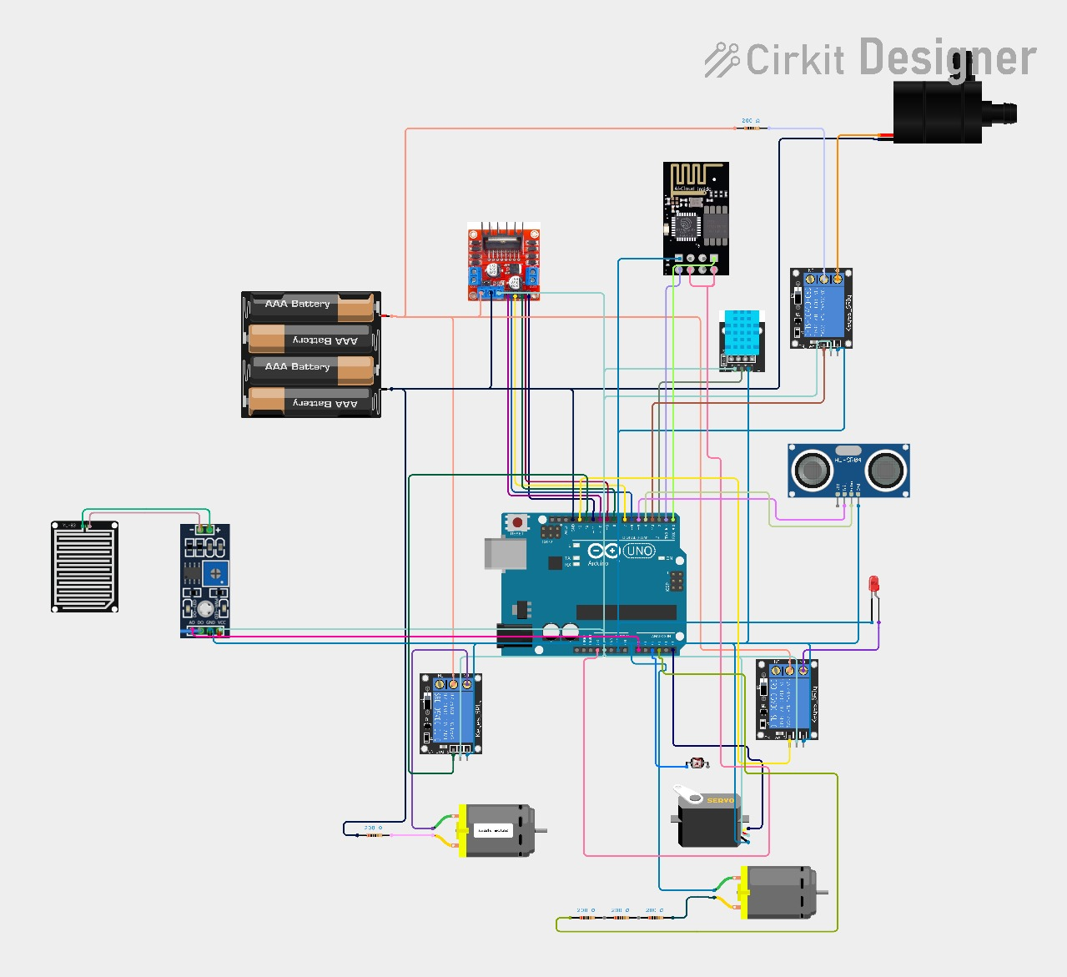
THE CIRKIT OF THE PROJECT

Slide 20
عمل الطالب : محمد ماهر زلوم
بإشراف : الدكتور أحمد الخطيب
المهندس يزن الربايعة

Slide 21

الحمدلله

